Slide 1
Firewalls
By Carlos Gerez Garcia, Christopher Ditto, and Mark Riley Slik

Slide 2
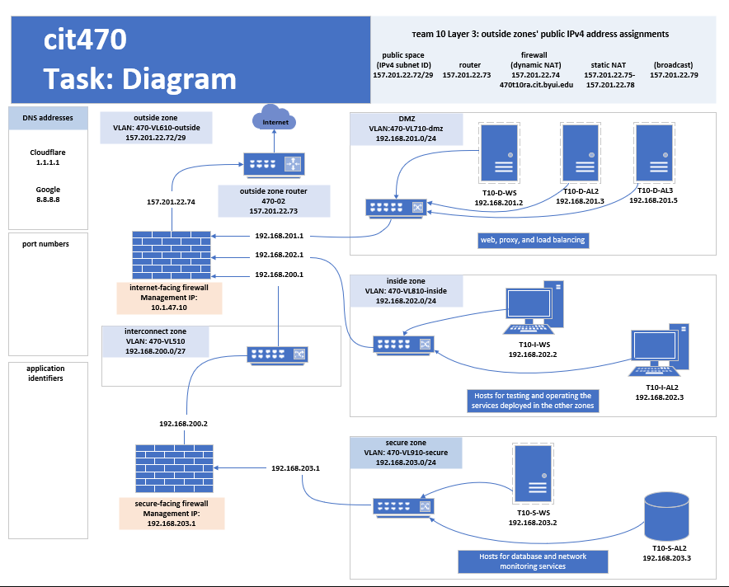
Diagram Outline for Team 10

Slide 3
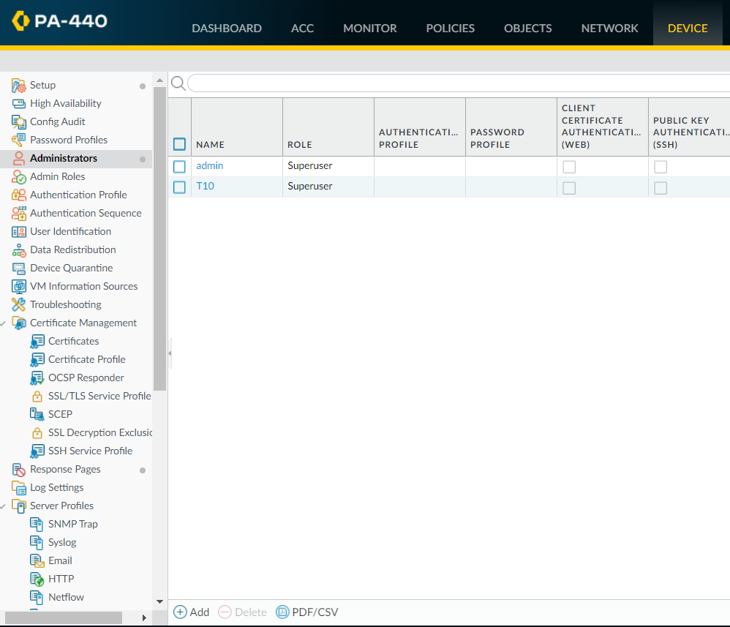
Palo Alto PA-440 Configuration
Log into Palo Alto GUI, using the credentials given by the course instructor.
Once inside the GUI click on ‘Administrators’ and then on ‘Add’ at the bottom of the page

Slide 4
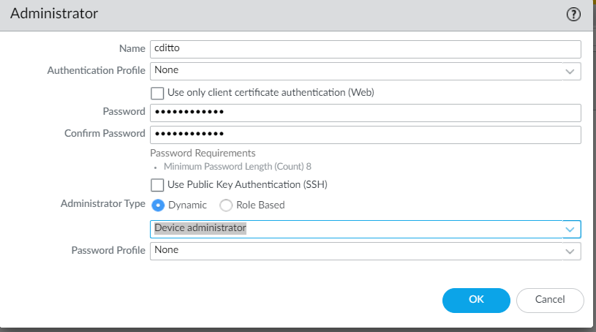
Palo Alto PA-440 Configuration
Create a new administrative account.
Each member off the team should create their own administrative account.

Slide 5
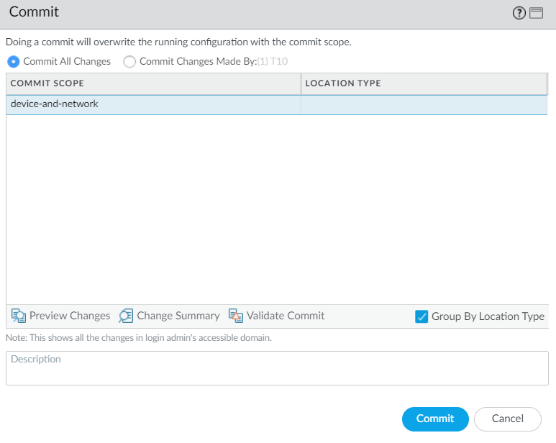
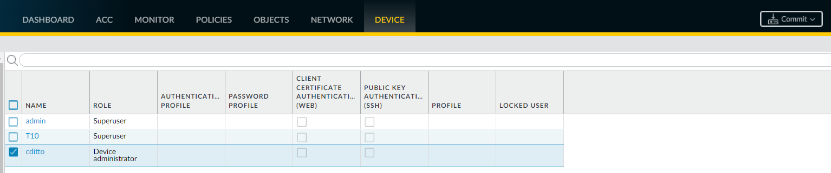
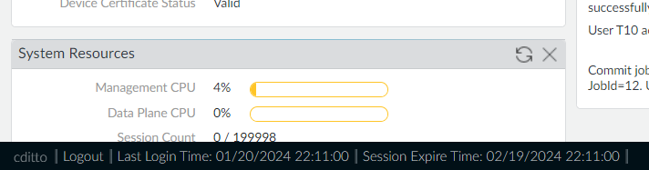
Palo Alto PA-440 Configuration
After Creating the new account commit your changes, log out using the button at the bottom left corner.

Slide 6
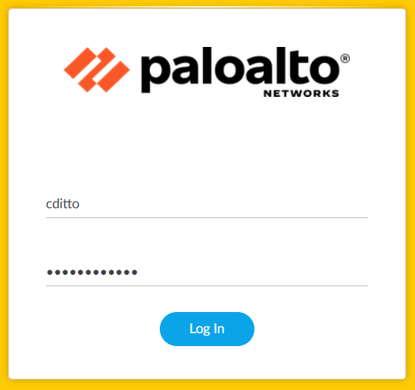
Palo Alto PA-440 Configuration
Log back in using the new credentials

Slide 7
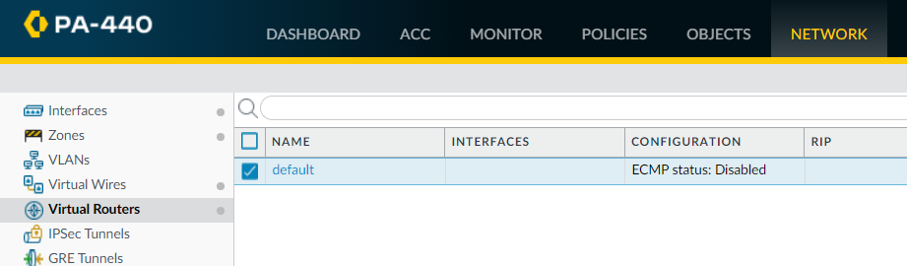
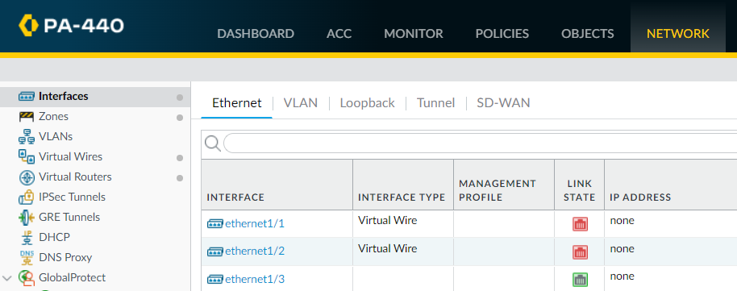
Palo Alto PA-440 Configuration
Select ‘Virtual Router’ from the left menu.
Use the default router unless instructed otherwise.
Select ‘Interfaces’,find the physical port labeled ‘ethernet1/3’ and click the label

Slide 8
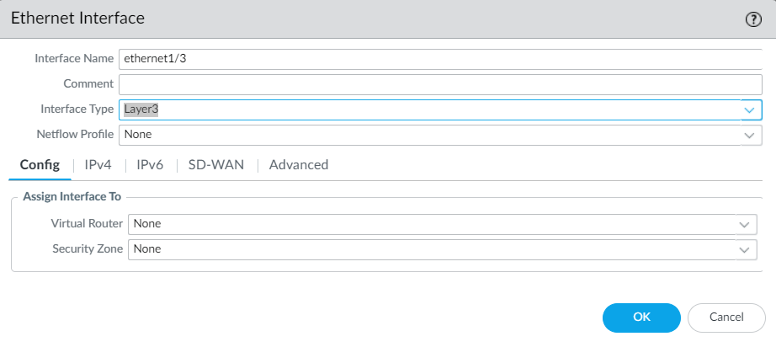
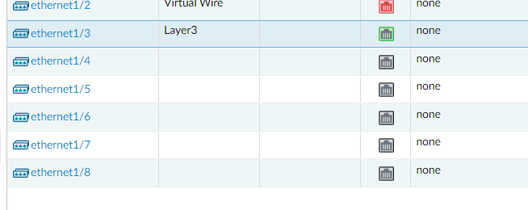
Palo Alto PA-440 Configuration
Change the ‘Interface Type’ to ‘Layer3’.
Click OK.

Slide 9
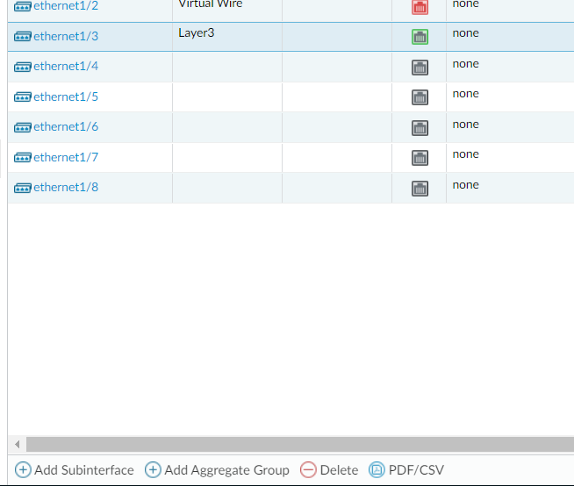
Palo Alto PA-440 Configuration
Highlight ‘ethernet1/3’ then click on ‘Add Subinterfaces’

Slide 10
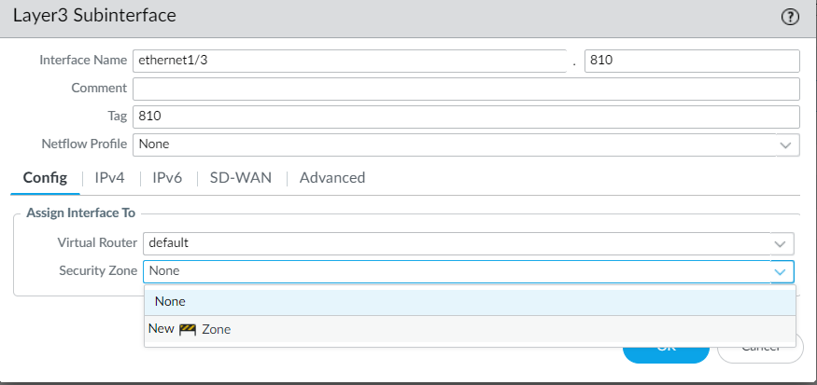
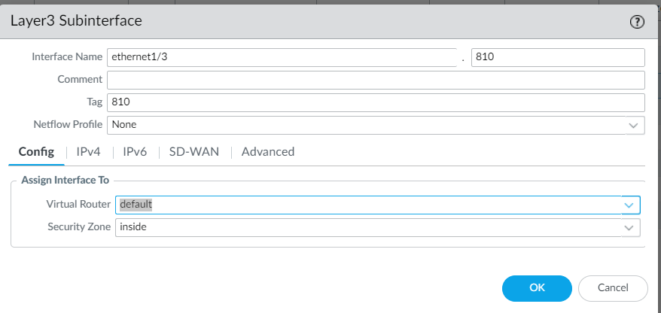
Palo Alto PA-440 Configuration
Click on the ‘Config’ tab
Add the subinterface number and duplicate for the tag as per best practice.
Add default to the ‘Virtual Router’ and then click on the dropdown in the Security Zone and add New Zone.
Change zone to ‘inside’.

Slide 11
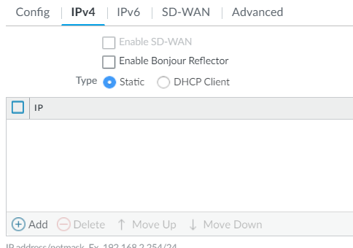
Palo Alto PA-440 Configuration
Select the ‘IPv4’ tab.
Select IP and add the IP address reserved for your teams firewall. Be sure to include the subnet mask suffix in CIDR notation.

Slide 12
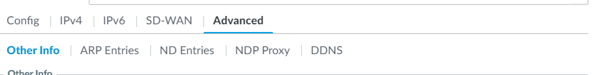
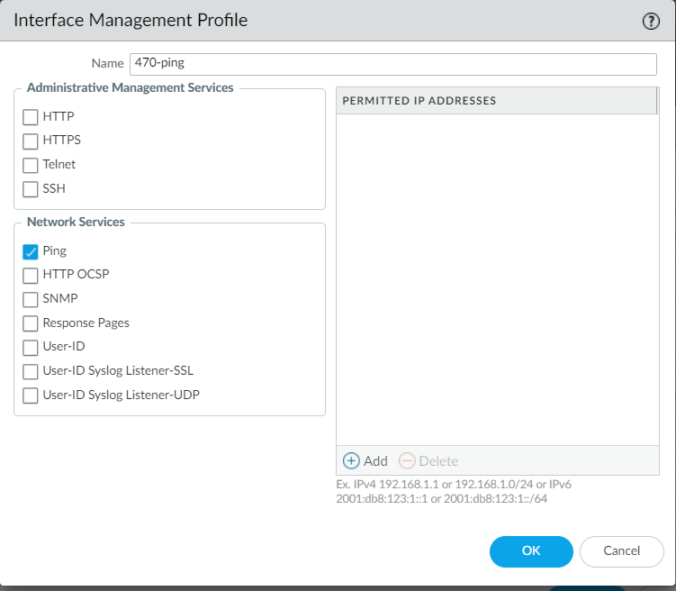
Palo Alto PA-440 Configuration
Select the ‘Advanced’ tab then select ‘Management Profile’
Create a profile named ‘470 pin’ and enable the ping option in that new profile.
Click OK.

Slide 13
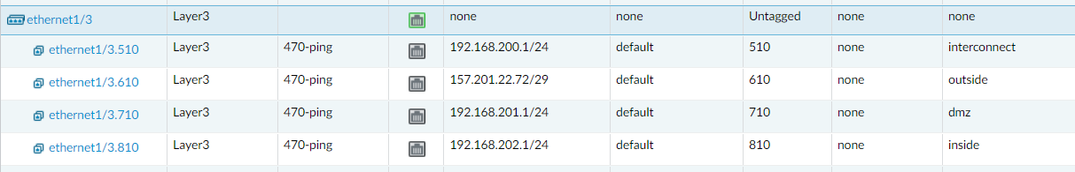
Palo Alto PA-440 Configuration
Check your work in the interface table and adjust any misconfigurations.

Slide 14
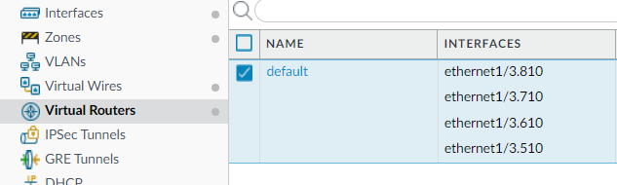
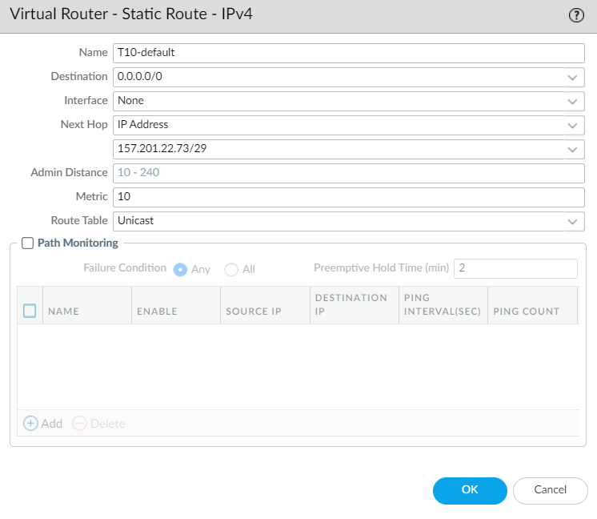
Palo Alto PA-440 Configuration
Select ‘Virtual Routers’ again then select the teams virtual router.
Click the ‘Static Route’ subtab, then create a new static route.
Name the route after your teams number and the word default.
The default route should be 0.0.0.0/0 which is the network ID for the whole internet.
The IP address of the next hop should be set to your teams assigned gateway router.

Slide 15
Palo Alto PA-440 Configuration

Slide 16
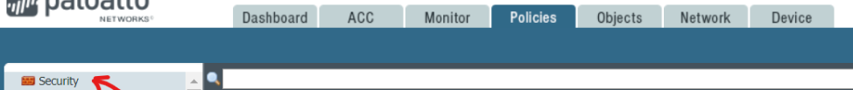
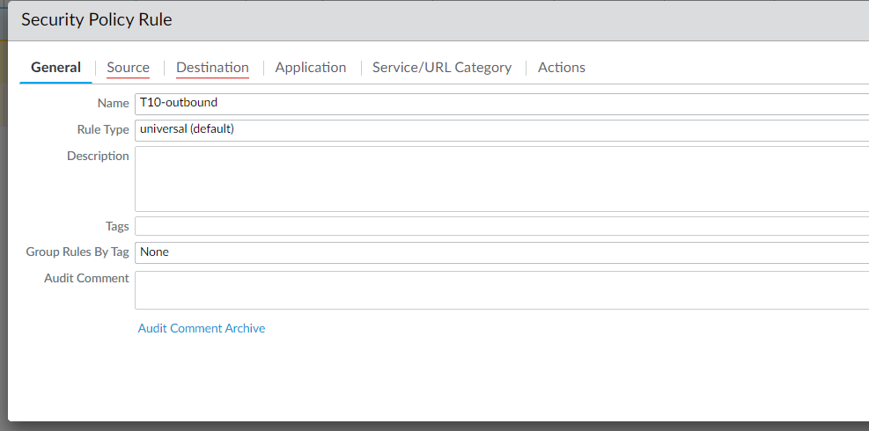
Palo Alto PA-440 Configuration
Click the ‘Policy’ tab.
Select ‘Security’ then click ‘Add’ at the bottom corner to set a new security rule.
You will set an outbound ‘client’ server that will allow inside zines to access Internet servers via your outside zone.
Set the name to your team name-Outbound and the rule type to universal.

Slide 17
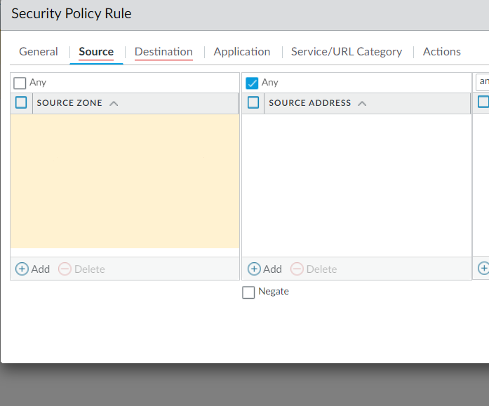
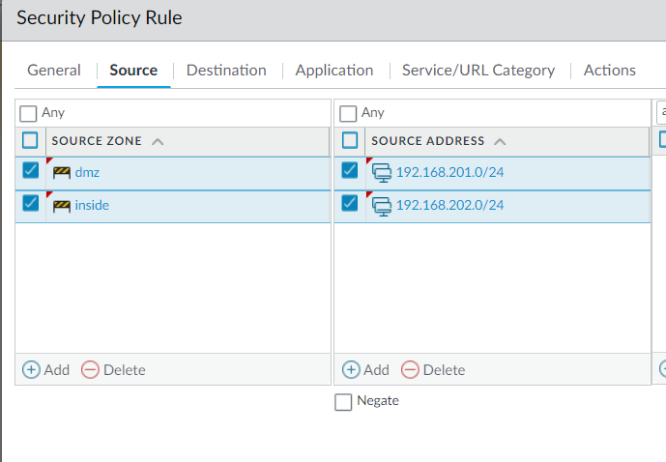
Palo Alto PA-440 Configuration
Select the ‘Source’ tab and then click on Add.
Add your DMZ, then click ‘Add’ then add your inside zone.
Under ‘Source Addresses’ click ‘Add’ and enter your teams DMZ subnet and the repeat with your inside zone subnet.

Slide 18
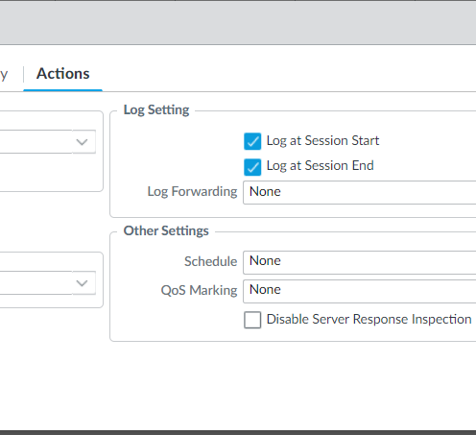
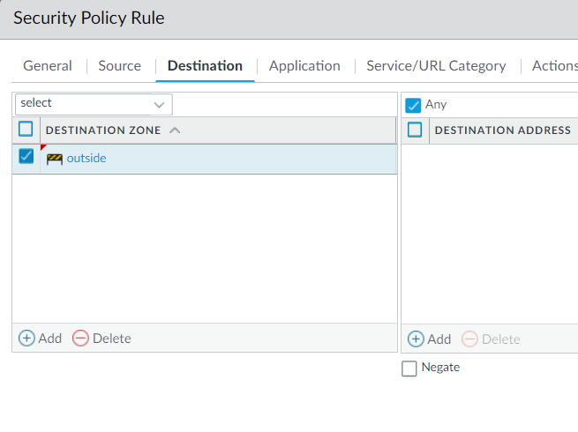
Palo Alto PA-440 Configuration
Select the ‘Destination’ tab then use the same procedure to add the outside zone
Select ‘Actions’ tab then check the ‘Log at Session Start’ and ’Log at Session End’ boxes.

Slide 19
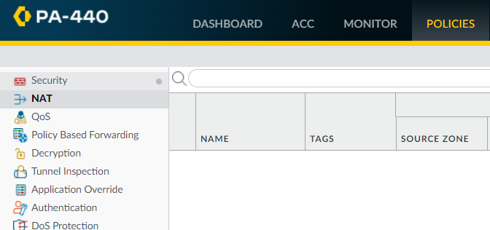
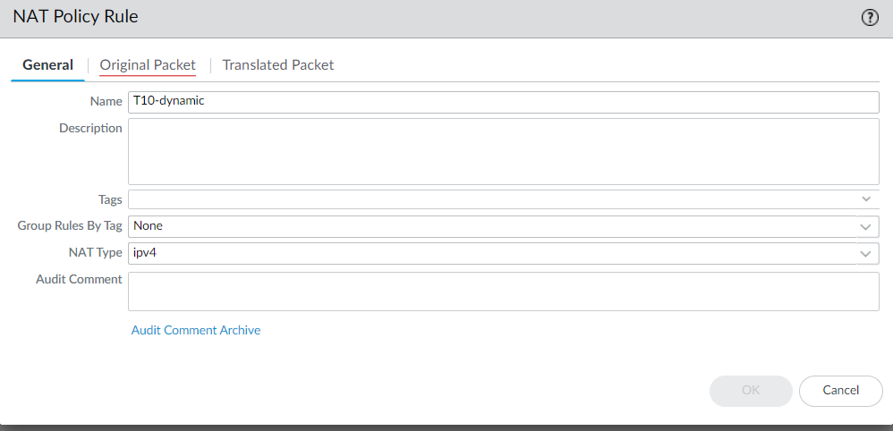
Palo Alto PA-440 Configuration
Select ‘NAT’ on the left and then select ‘Add’.
Under the ‘General’ tab name the new policy after your team name and the word dynamic.

Slide 20
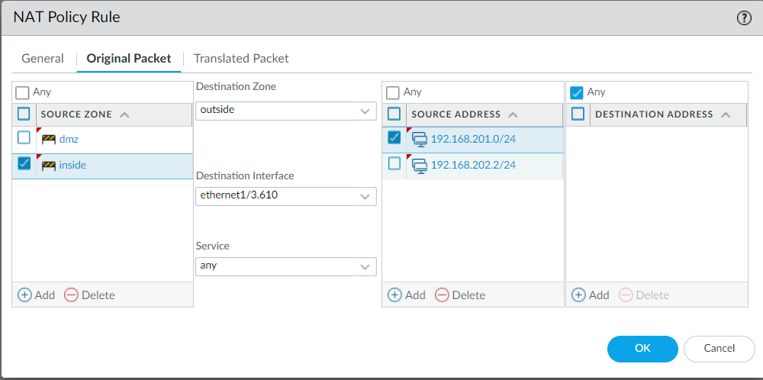
Palo Alto PA-440 Configuration
Click the ‘Original Packet’ tab.
Specify the teams DMZ and inside zones as source zones and specify the correct numbered subinterface for the teams outside zone.

Slide 21
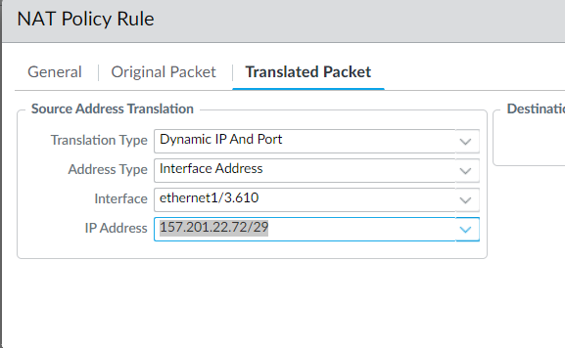
Palo Alto PA-440 Configuration
Select the ‘Translated Packet’ tab.
Change the ‘Transition Type’ to ‘Dynamic IP and Port’
Change the ‘Address’ to ‘Interface’
Specify the numbered subinterface of your outside zone Address’
Finally, select the IP address that was assigned to that subinterface.
Click OK

Slide 22
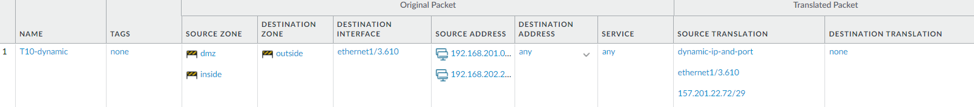
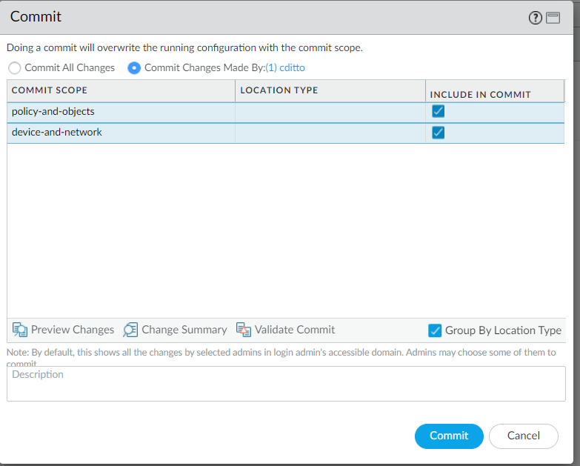
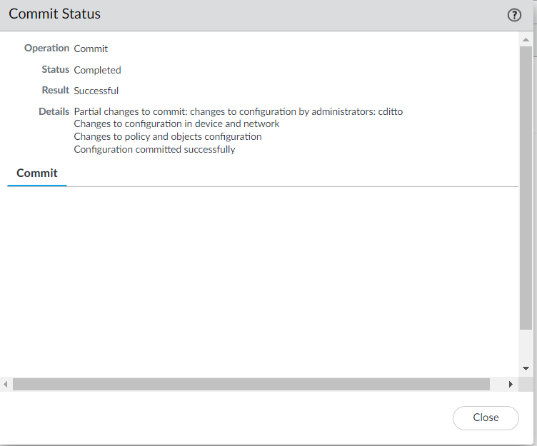
Palo Alto PA-440 Configuration
Review your new NAT rule
Commit your changes.

Slide 23
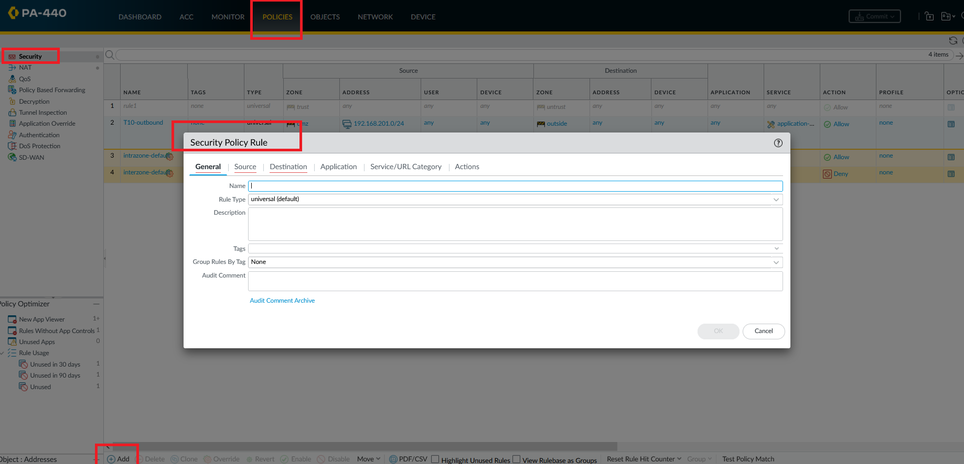
Add a Security Policy for Applications ssh and remote access to give access from DMZ to inside Zone.

Slide 24
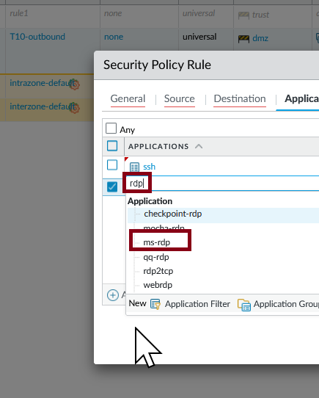
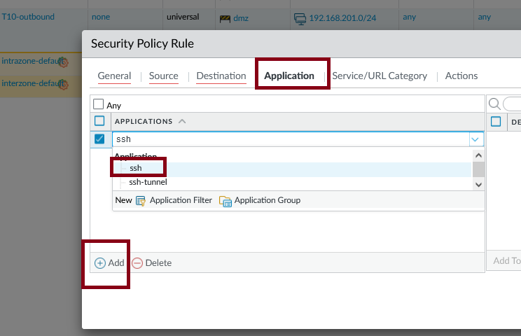
Add a Security Policy for Applications ssh and remote access to give access from DMZ to inside Zone.

Slide 25
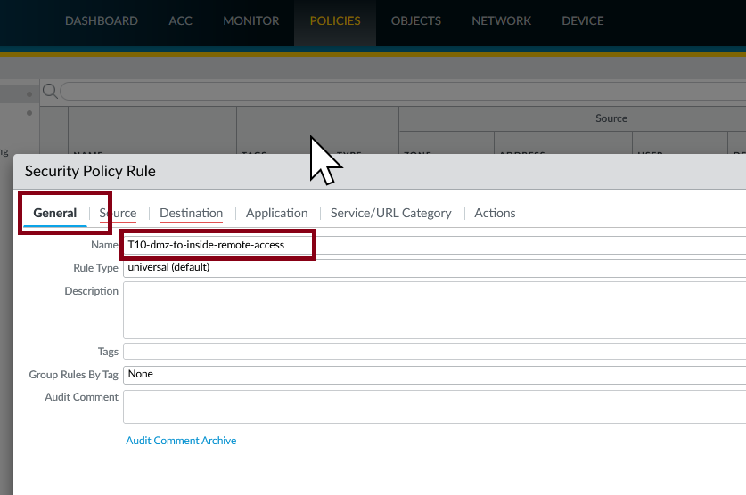
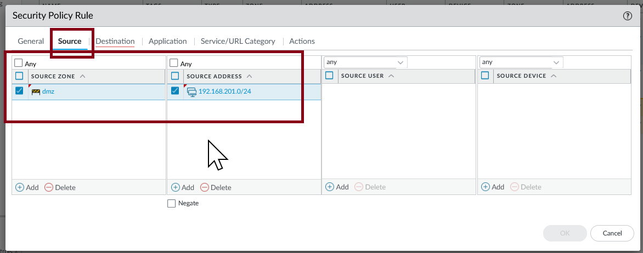
Add a Security Policy for Applications ssh and remote access to give access from DMZ to inside Zone.

Slide 26
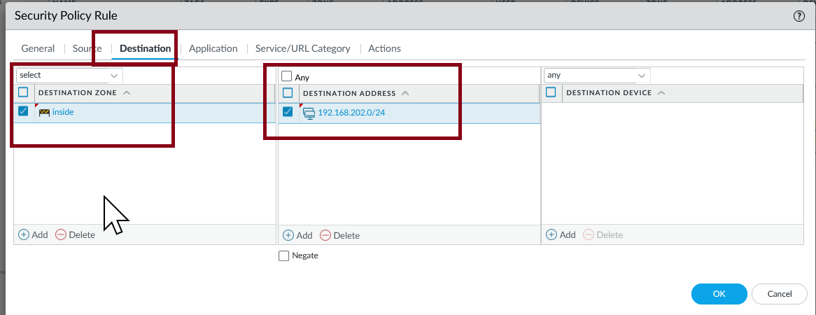
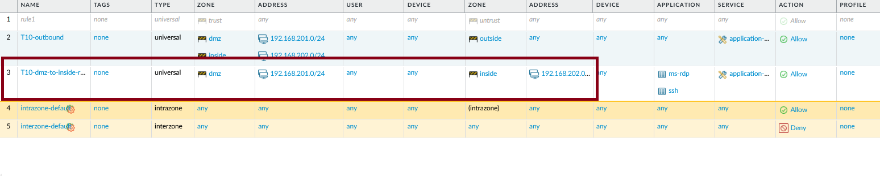
Add a Security Policy for Applications ssh and remote access to give access from DMZ to inside Zone.

Slide 27
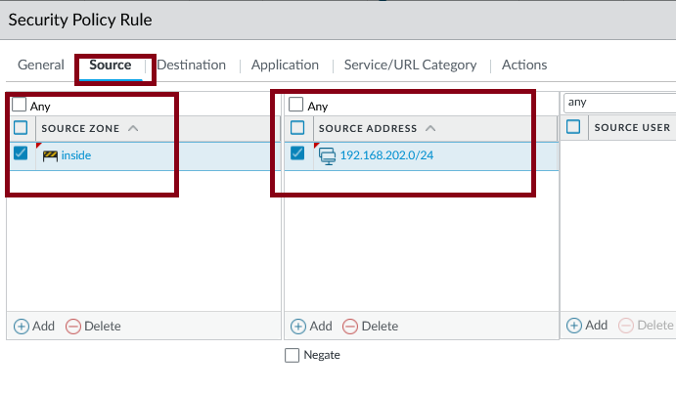
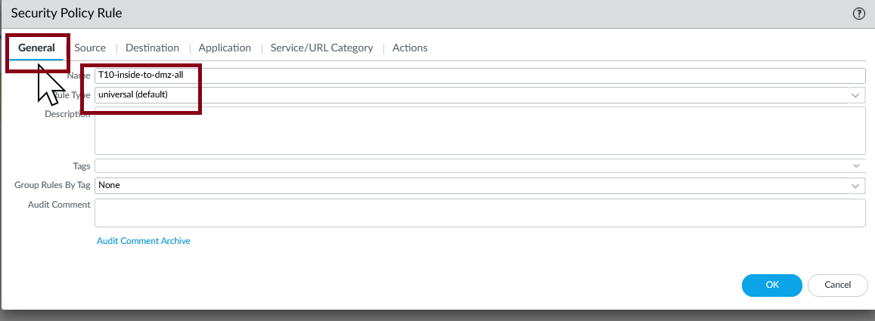
Add a Policy Rule to allow all traffic from inside towards DMZ.

Slide 28
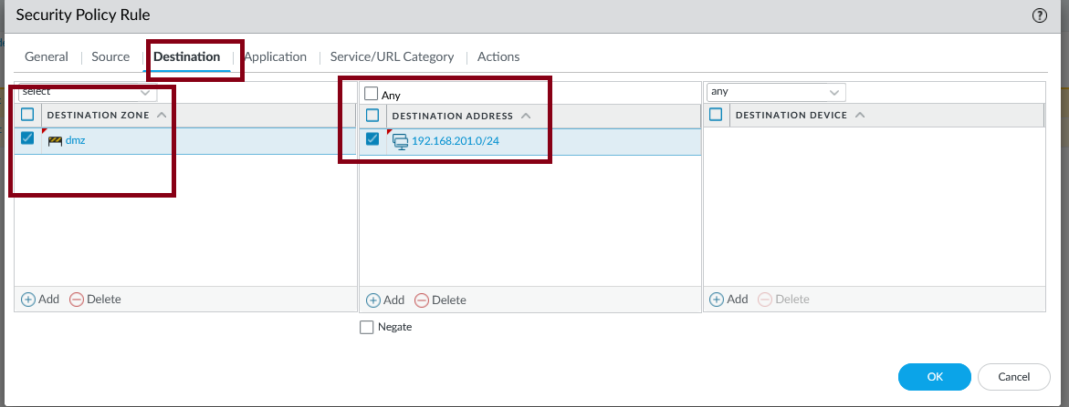
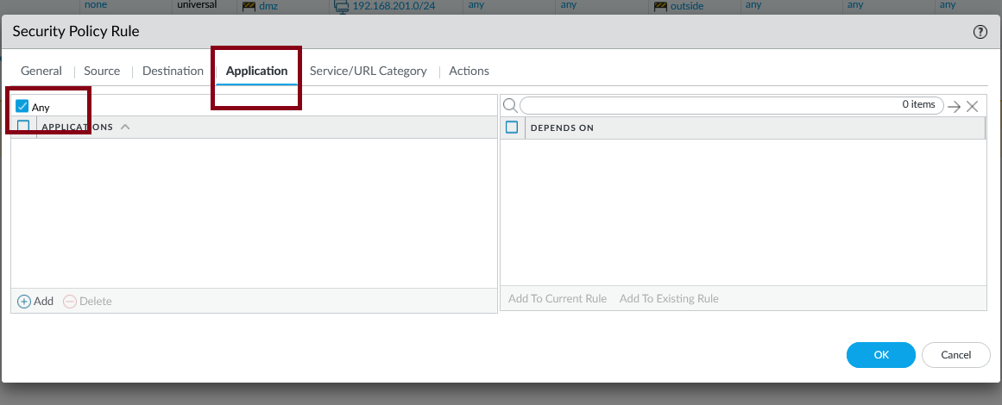
Add a Policy Rule to allow all traffic from inside towards DMZ.

Slide 29
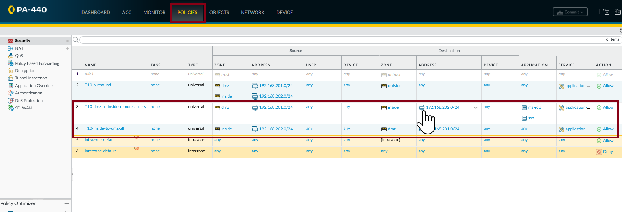
The new rules created for Remote Desktop and for the intern zone.

Slide 30
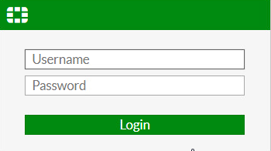
Fortigate Configurations
Connect to your windows secure server and connect to Fortigate by using a web browser and entering the ip address for your gateway. You should have the login credentials

Slide 31
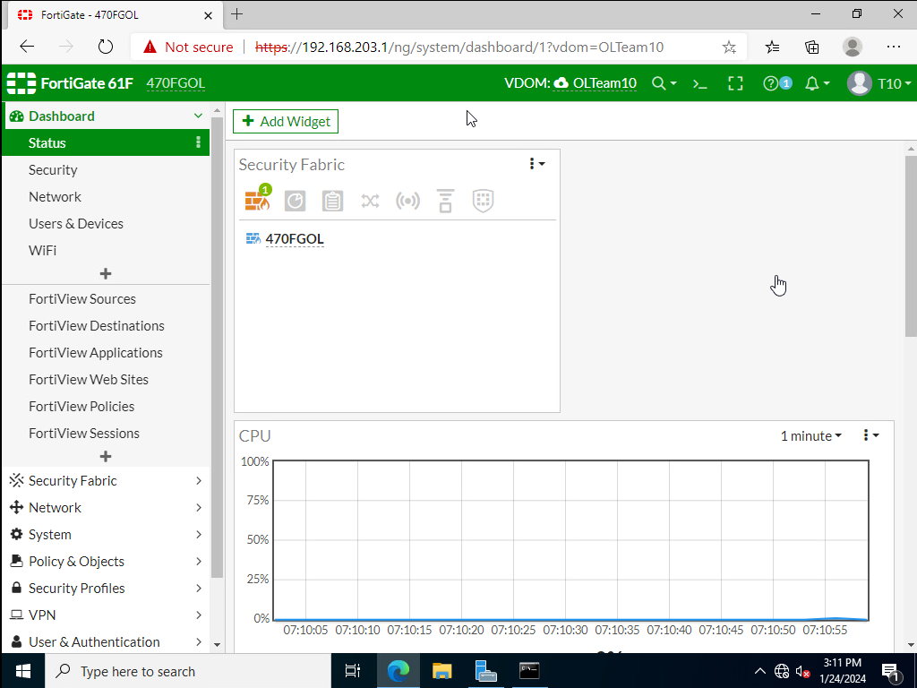
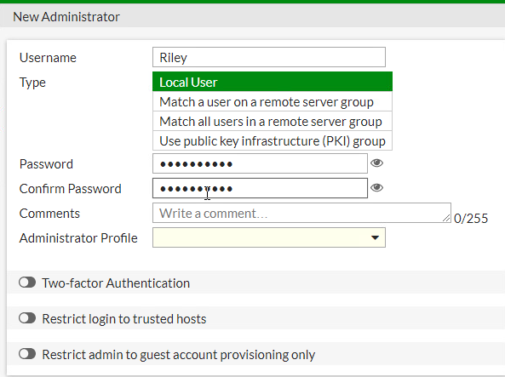
Go to System Administrator and make new Admin account for yourself

Slide 32
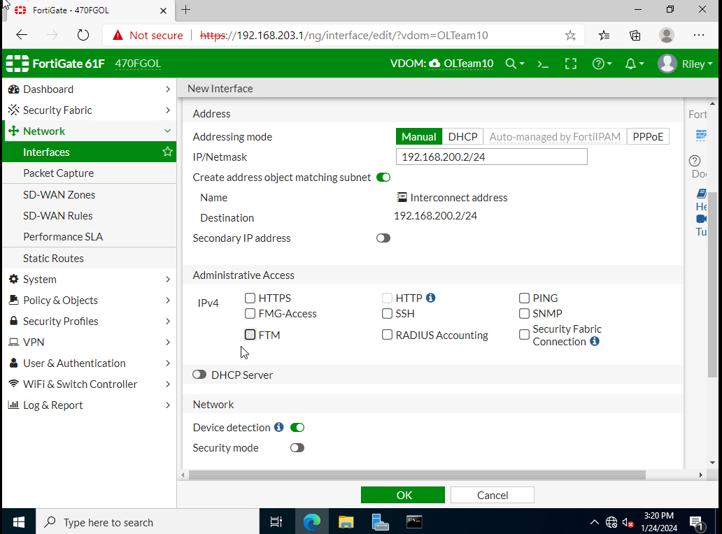
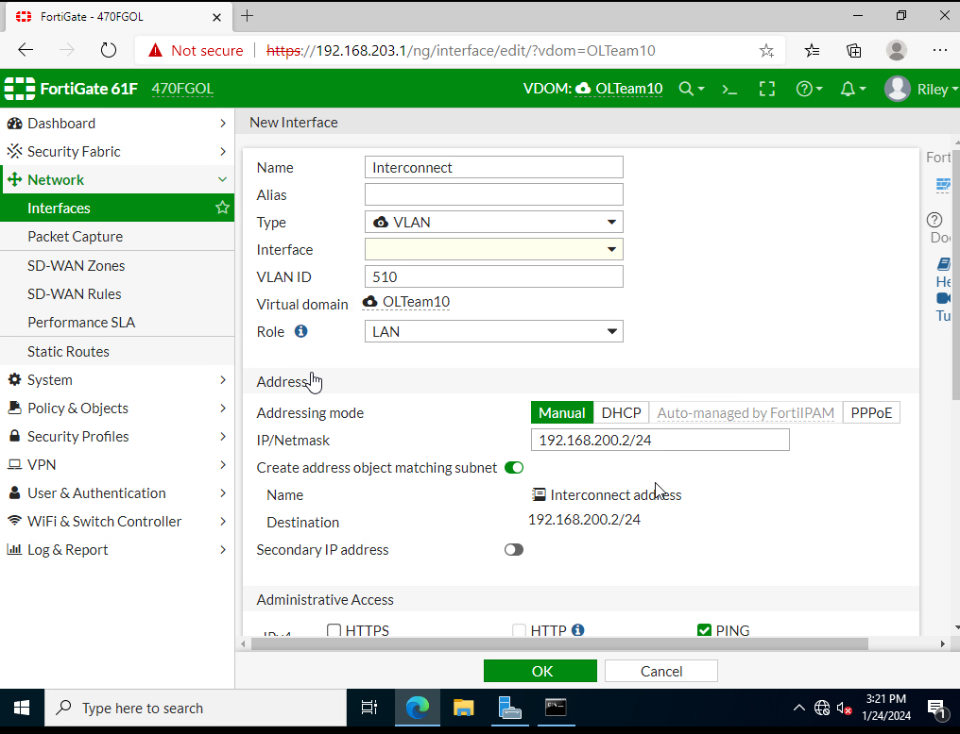
Go to Interface and make new one for the interconnect Zone making sure to fill out the vlan and Ip info and enabling ping

Slide 33


Make a Static route going to the Palo Altos Firewall in the interconnect zone

Slide 34

Go to Policy & Object select address and choose new address and add an object for each zone

Slide 35


Inside of Policy & Objects select Firewall policies and make an outbound and rdp/ssh policies using the new object you made.

Slide 36

Review all the Policies and enable ALL for logging

Slide 37
Challenges we faced

Slide 38

Misconfiguration in Palo Alto firewall.
We didn't have connections from the secure zone since we configure Palo Alto policy with the ip range from the firewall instead of the secure zone. We find the problem when we review our diagram and tested the change.
Was corrected from 192.168.200.0/24 to 192.168.203.0/24.

Slide 39

Linux SSH connections $PATH problems.
On the Linux systems on intern, the ssh connection where established towards secure zone, but the terminal just stale without showing the terminal in the secure zone we were connecting.
After checking ssh packages in that machine using Wireshark we realized that the connection exist, and that means that the problem was not in the firewalls, but in the ssh configuration on the Linux we run ssh. We run ssh with the full path ( /usr/bin/ssh) and worked. The misconfiguration was in the $PATH to ssh.

Slide 40

Linux SSH connections $PATH problems.
Use of filters on Wireshark to isolate ssh connections.

Slide 41
Connectivity tests.

Slide 42

Testing connectivity with ping between zones
From DMZ zone.

Slide 43

Testing connectivity with ping between zones
From inside zone.

Slide 44

Testing connectivity with ping between zones
From secure zone.

Slide 45

Testing connectivity with ssh between zones
From inside to secure ssh.

Slide 46

Testing connectivity with ssh between zones
From DMZ to secure ssh

Slide 47

Testing connectivity with ssh between zones
From secure to inside ssh

Slide 48

Testing connectivity with ssh between zones
From secure to DMZ ssh

Slide 49

Testing Remote Desktop connectivity between zones
DMZ to inside zone.

Slide 50

Testing Remote Desktop connectivity between zones
Inside to DMZ zone.

Slide 51

Testing Remote Desktop connectivity between zones
Inside to secure zone.

Slide 52

Testing Remote Desktop connectivity between zones
DMZ to secure zone.

Slide 53

Testing Remote Desktop connectivity between zones
Secure to DMZ.

Slide 54

Testing Remote Desktop connectivity between zones
Secure to Inside.

